Slide 1
CNN and Maxout

Slide 2
Questions from the discussion
Convolutional Neural Networks:
ImageNet Classification with Deep Convolutional Neural Networks – Krizhevsky 2014
Visualizing and Understanding Convolutional Neural Network – Zeiler 2013

Slide 3
AlexNet
ReLU.
2 GTX 580 GPU with 3GB memory to be trained using 1.2 million training examples. These communicate only over certain layers.
Local Response Normalisation. This is applied to encourage lateral inhibition (the capacity of a neuron to reduce the activity of its neighbors). (k = 2, n = 5, α = 10⁻⁴ and β = 0.75)
Overlapping Pooling.
Krizhevsky

Slide 4

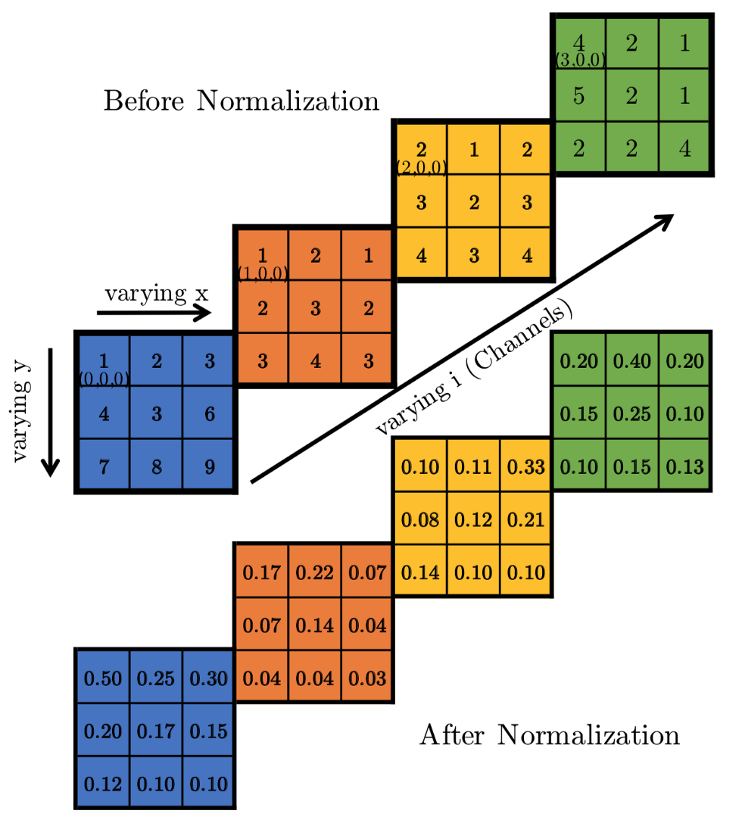
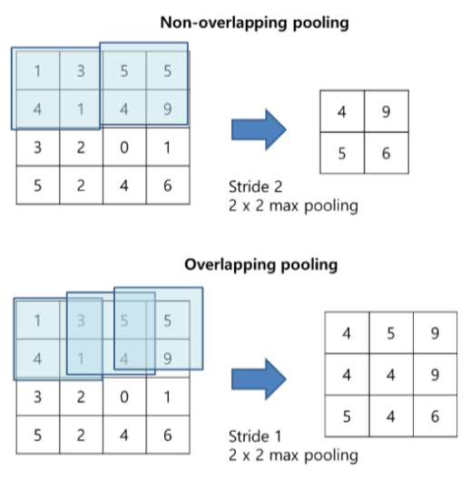
Krizhevsky

Slide 5
AlexNet
The first convolutional layer filters the 224×224×3 input image with 96 kernels of size 11×11×3 with a stride of 4 pixels.
The second convolutional layer takes as input the (response-normalized and pooled) output of the first convolutional layer and filters it with 256 kernels of size 5 × 5 × 48.
The third convolutional layer has 384 kernels of size 3 × 3 ×256 connected to the (normalized, pooled) outputs of the second convolutional layer. The fourth convolutional layer has 384 kernels of size 3 × 3 × 192 , and the fifth convolutional layer has 256 kernels of size 3 × 3 × 192. The fully-connected layers have 4096 neurons each
Krizhevsky

Slide 6
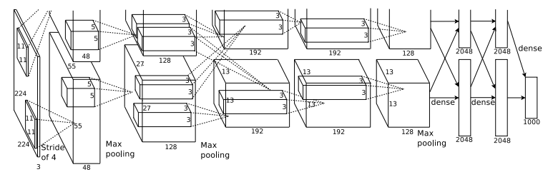
Structure of AlexNet
Response-normalization layers follow the first and second convolutional layers. Max-pooling layers, follow both response-normalization layers as well as the fifth convolutional layer. The ReLU non-linearity is applied to the output of every convolutional and fully-connected layer.
Krizhevsky

Slide 7

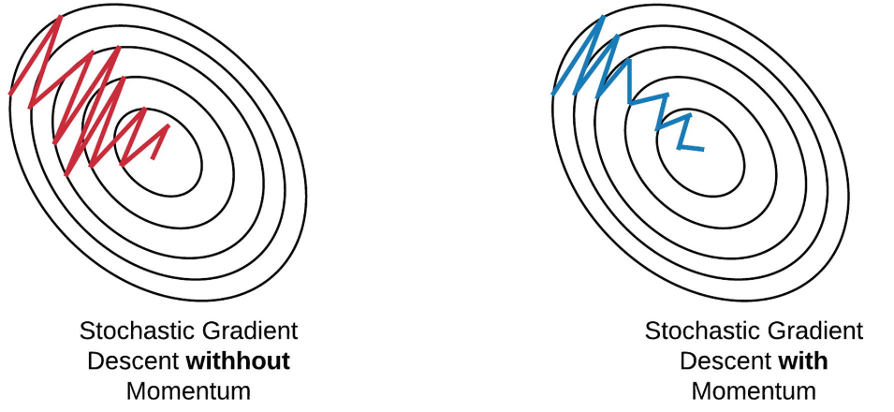
Training of AlexNet
Batch size = 128
Bias in all layers = 1
Weight updating formula:
Krizhevsky

Slide 8
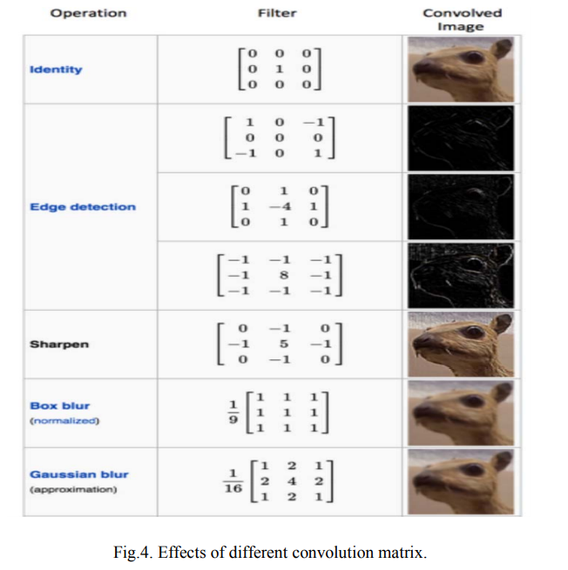
Pre defined matrices

Slide 9
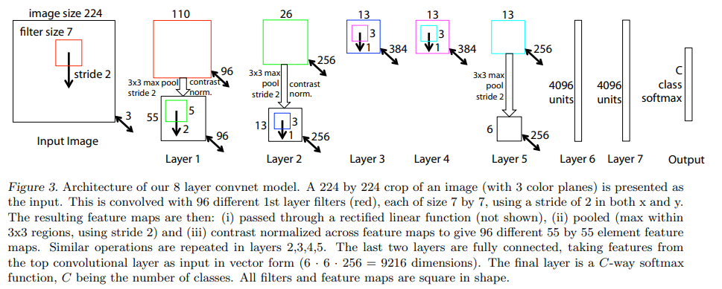
Structure of CNN discussed by Zeiler
Single GPU, dense connections
Zeiler

Slide 10
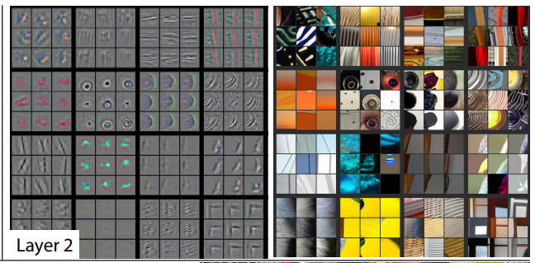
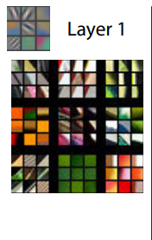
Feature maps with top 9 Activations
Zeiler

Slide 11
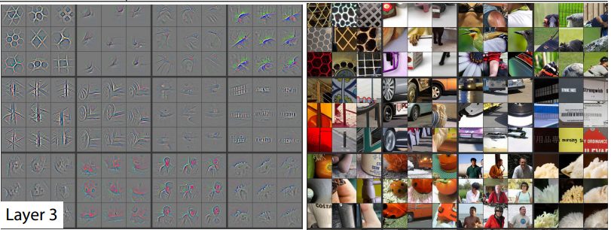


Slide 12
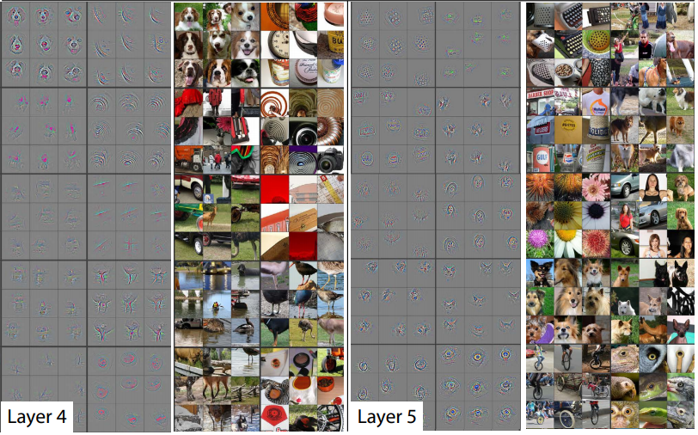

Slide 13
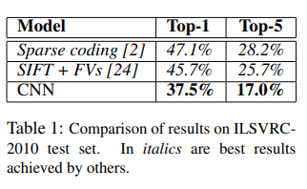
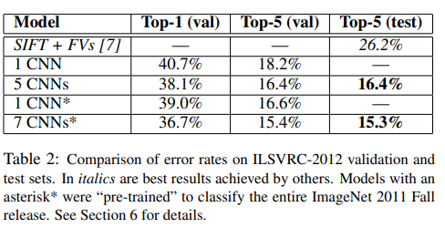
Results of AlexNet
Krizhevsky

Slide 14
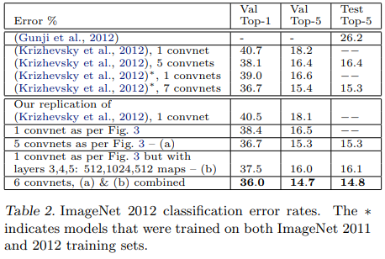
Results comparing the 2 CNNs

Slide 15
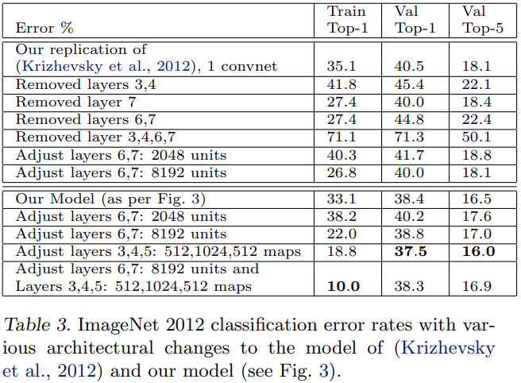
Results comparing the 2 CNNs

Slide 16
Questions from the paper
Max out unit in a neural network –
Maxout Networks (Goodfellow et al.)
Evaluation of maxout activations in deep learning across several big data domains (Gabriel Castaneda et al.)

Slide 17
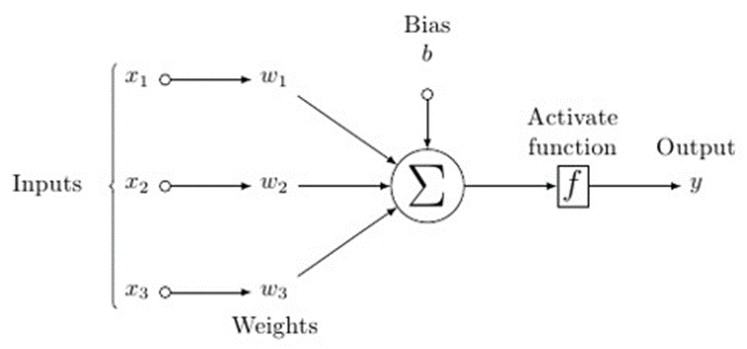
How is Maxout applied

Slide 18

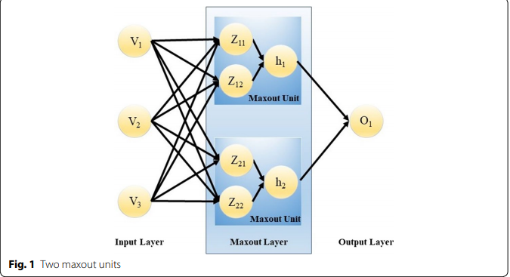
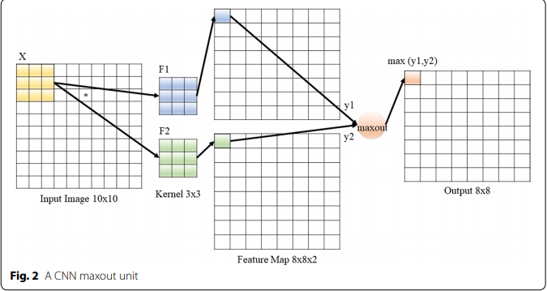
Maxout units in various networks
Castaneda et al

Slide 19
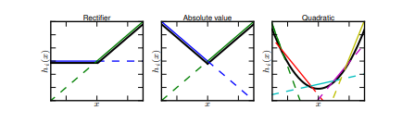
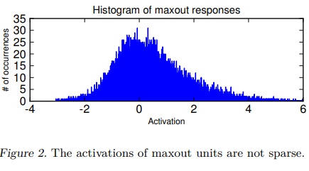
Maxout units in various networks
Goodfellow et al

Slide 20
Maxout v/s ReLU + Max pooling
The only difference between maxout and max pooling over a set of rectified linear units is that maxout does not include a 0 in the max. Superficially, this seems to be a small difference, but we find that including this constant 0 is very harmful to optimization in the context of dropout.
Because the 0 in the max(0, z) activation function is a constant, this blocks the gradient from flowing through the unit. In the absence of gradient through the unit, it is difficult for training to change this unit to become active again. Maxout does not suffer from this problem because gradient always flows through every maxout unit–even when a maxout unit is 0, this 0 is a function of the parameters and may be adjusted Units that take on negative activations may be steered to become positive again later.
Goodfellow et al

Slide 21
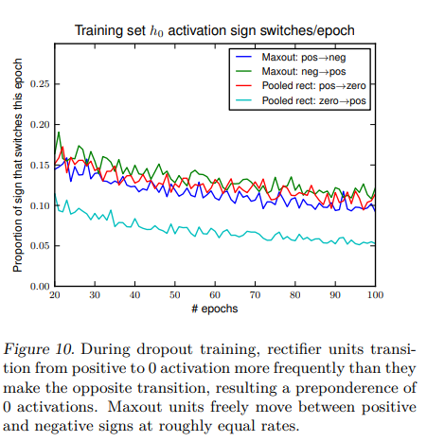
Maxout v/s ReLU + Max pooling
Goodfellow et al

Slide 22
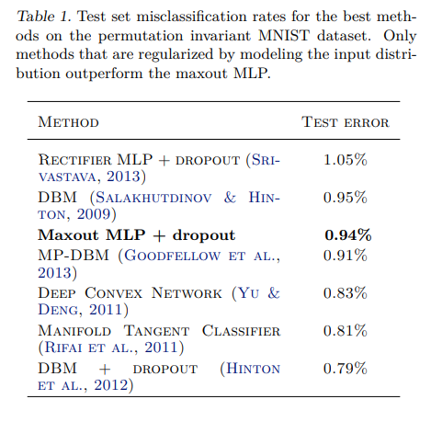
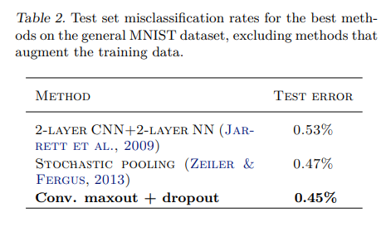
Error rates
Goodfellow et al

Slide 23
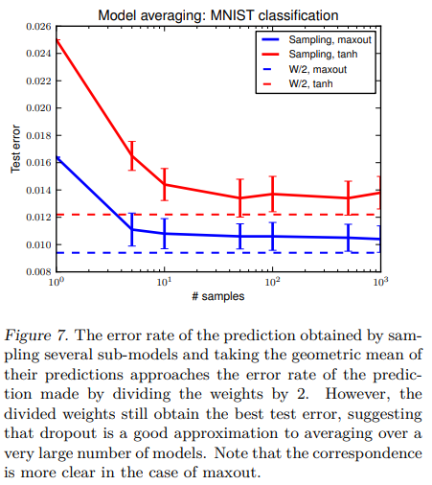
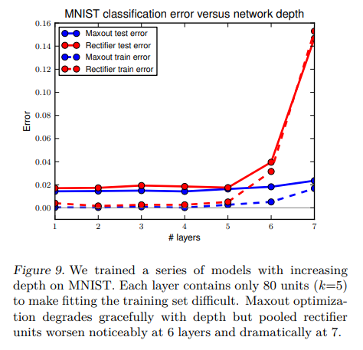
Error rates
Goodfellow et al

Slide 24
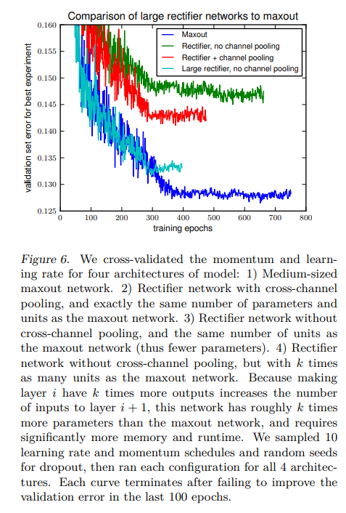
Error rates
Goodfellow et al

Slide 25
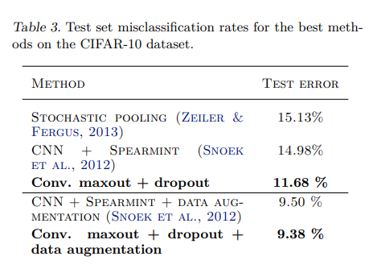
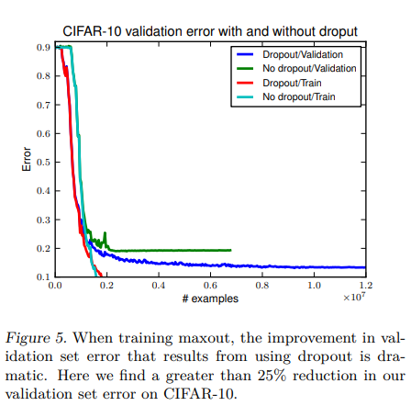
Error rates
Goodfellow et al

Slide 26
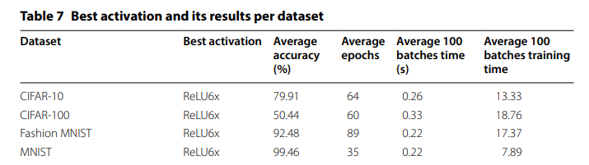
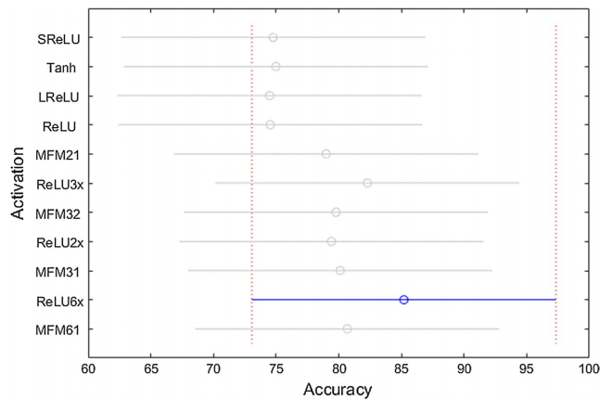
Castaneda et al

Slide 27
Results
Due to high performance and fast training relative to other top performing activations, ReLU6x is the recommended activation function for image datasets.
(ReLU2x for text datasets. On the sound datasets, maxout 2-1 is the recommended activation function.)
Our results suggest the higher the memory usage the higher the accuracy.
Castaneda et al

